Slide 1
TOIstudent - Digital Strategy and Roadmap Executive Deck
Final Presentation to Steering Committee
19th December 2017

Slide 2
Agenda
List of Stakeholders Met
Value Propositions summary
Business Model Framework
Appendix

Slide 3
During the 3rd VOC Survey, we conducted focus interviews of 87 students
Conducted 3 Voice of Customer Surveys for inputs from Primary Audience i.e. Students.
Students were grouped by Grades (5th-6th , 7th-8th and 9th+)
VOC - 1
VOC - 2
VOC - 3
Objective : Why students visit websites, choice of format, and channel & browsing patterns
Format : Questionnaire & Focus Group Discussion
Cities : Mumbai & Delhi
Sample Size : 41 Students & 13 Teachers
Objective : Understand Value Proposition preferences & browsing behavior
Format : Web Survey
Sample Size : 2200+ Students
Objective : Validate features of future website
Format : Prototype Images & Questionnaire
Cities : Mumbai, Delhi NCR, Jaipur, Chandigarh, Cochin and Bangalore
Sample Size : 87 Students

Slide 4
A Five Pillar Business Model Framework is Used for Recommending the Roadmap
Team Structure
Business Potential
Job Descriptions
Revenue Model
PEOPLE
MARKETING
& PUBLICITY
Market Size
BUSINESS
TECHNOLOGY
CONTENT
Internal vs. External
Print-Digital-Print
Value Props
Mobile First
Video
Categories
Channels (Offline, Digital)
Sample User Journeys
Cost Models
Times Group Widgets
Times Points
CMS
Personalization
Formats
Website vs. App

Slide 5
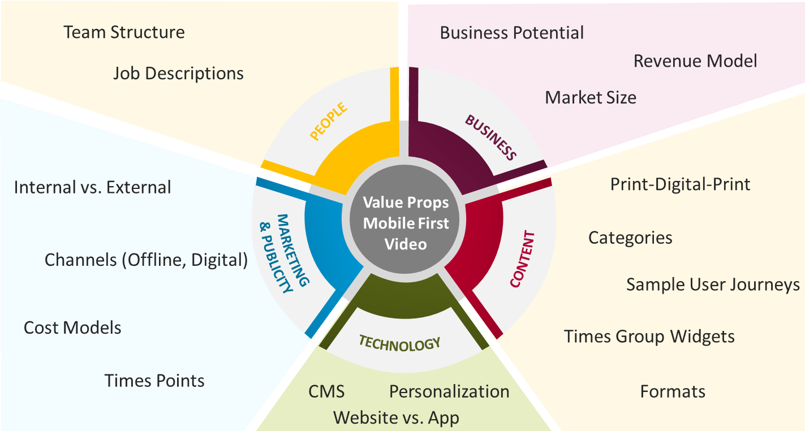
CONTENT
- Categories
- Print-Digital-Print
- Times Group Widgets
- Times Points
- Sample User Journeys
- Content Formats
In Appendix

Slide 6

Print-Digital-Print Strategy (Use Cases) Ways to increase print-engagement using the digital channel
8 use cases were presented to students during VOC 3 to know their preference
S. No | PRINT ENGAGEMENT |  | DIGITAL ENGAGEMENT |  | PRINT ENGAGEMENT | ENDORSEMENT BY STUDENTS (%)
1 |  |  | Debate or poll |  | Leaderboard
2 | Article |  | Related quiz |  | Leaderboard
3 |  |  | Ask Experts (Webinars, Webchat) |  | Answers to the best questions
4 | Article |  | Related video
5 | ‘Quiz of the day’ |  | ‘Quiz of the day’ |  | Leaderboard
6 | Article in ‘your corner’ |  | Like, comment, share
7 | Introduction to an article |  | Detailed story
8 |  |  | Letters to the Editor |  | Featured letters to Editor
9 | Campaign |  | Submit related articles/ photos |  | Featured campaign articles
75%
66%
60%
56%
55%
49%
39%
34%
Recommendation
The PDP engagement strategy should be driven by online quizzes and polls related to print articles, and webinars

Slide 7







Students have a strong preference for gamified, news, and topic oriented apps/ websites
2
1
Topic Centric Website/App
Gamification of Learning
36%
23%
22%
3
Value
Propositions
4
5
Students
Teachers
Parents
School
Rewards & Recognition
12%
7%
Online Community Platform
Recommendation
The website should offer 3 primary value propositions to the TG – ‘News for Students’, ‘Topic Centric Content’, and ‘Gamified Learning’

Slide 8
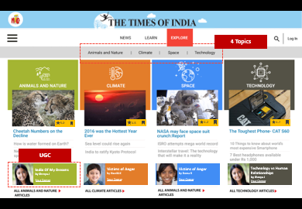
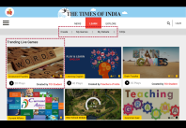
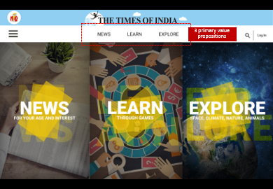
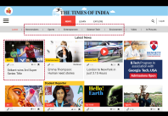
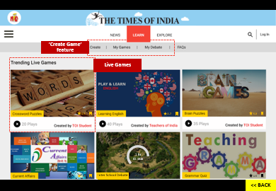

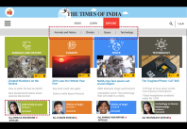
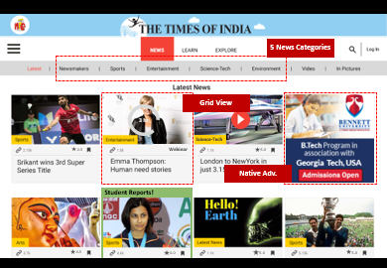
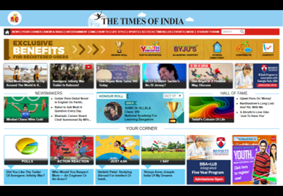

Availability of multiple CATEGORIES and sub-categories needs to be revisited
TOI STUDENT
As Is
NEWS
TOP NEWS
NEWS IN ATLAS
NEWSMAKERS
YOUR CORNER
POLLS
ACTION REACTION
JUST ASK
I SAY
MUST SEE MUST DO
COUNSELLING
KNOW AND BRAG
ENTERTAINMENT
BOOKMARK
OMG
EPIC
WHO AM I
HOLY TRAIL
WISE WORDS
HOW TO
ETIQUETTE
MOCK PAPERS
TIPS & TRICKS
LIFESTYLE
COOK IT UP
POST CARD
PUMP IT UP
HANGER
PETS
RELATIONSHIP
SPORTS
SCI-TECH
APPS
FEATURED
GADGETS
GAMING
SPACE
ENVIRONMENT
TIMEKILLER
GAMES
QUIZ
SODUKU
PUZZLES
POWER GRAMMER
JOKES
EVENTS
MORE
SCHOOL IS COOL
BEST OF PRINT
SCHOOL DIRECTORY
STUDENT FORUM
The categories need to be rationalized using the proposed value propositions
Recommendation

Slide 9
The proposed model includes fewer CATEGORIES identified based on multiple internal discussion and voice of customer surveys
TOI STUDENT
(Phase 1)
To-Be
NIE
USP
NEWS MAKERS
VOC 3
RANK 1
EMBEDDED THROUGHOUT
ENTERTAINMENT
MOVIES | MUSIC
NEWS
FOR STUDENTS
VOC 3
RANK 2
APPS | GADGETS | GAMING
VOC 1
TECHNOLOGY
SPORTS
VOC 1
SPACE | ENVIRONMENT
AUTO
VOC 3
RANK 3
SCIENCE
UGC
YOUR CORNER
VOC 3
RANK 2
TECHNOLOGY
SELF DEVELOPMENT
EXPLORE
TOPICS
NIE
USP
HEALTH | FASHION | COOKING | RELATIONSHIP | TRAVEL
COMM
UNITY
NIE
USP
ETIQUETTE | BOOKS | TIPS & TRICKS
EVENTS
SCIENCE
LIFESTYLE
VOC 3
RANK 3
VOC 3
RANK 2
NIE
USP
LEARN
THROUGH GAMES
TECHNOLOGY
SELF DEVELOPMENT
GK
SCIENCE
NIE
USP
VOC 3
RANK 3
Recommendation
Topic categories should be streamlined under the three proposed value propositions
# Based on VOC1, VOC3, and discussion with the content team

Slide 10
Article Page and Login
WIP

Slide 11












Times Group Resources Content, Website Widgets
Times group websites can provide plug-and-play content
Content will have to be sourced from diverse sources
Value Prop. | Category | Times Group Website | Content Format | Content %*
 | Top News |  | News Feed | 25%
 | Newsmakers | - | - | -
News | Sports |  | Live Scores | 20%
 | Entertainment |  | Audio, Twitter Feed | 20%
 | Science | - | - | -
 | Technology |  | Video | 25%
 | Auto |  | Video | 10%
 | Lifestyle |  | Video Horoscope Widget | 20%
Explore | Self Development | - | -
 | Science |  | Text | 10%
 | Technology |  | Text | 10%
Games | - |  | - | -
Original Content
(60%*)
TOIStudent
Content
External Sources
(~20%*)
Times Group Resources
(~20%*)
(To Be)
Recommendation
The website should have widgets and video galleries to showcase the content that is already available on TOI group websites
* Based on the no. of articles on a category page

Slide 12
We have identified multiple use cases for integrating Times Points
Times Points can be integrated with TOI Student in two areas
WIP
EARNING
REWARDS
REDEEMING
REWARDS
Ways To Earn Times Points
Reading content
Creating content
Sharing content
Participating in activities
Ways To Redeem Times Points
Buying products online
Buying premium content
Unlocking new stages of a game
Elevating membership band
want to level up*
85%
want premium content*
47%
29%
24%
Students said that they would engage more with a website if rewarded for it*
want to buy products using points*
A
B
Only 10% students want rewards in the form of points – the majority prefers recognition*
!
01
Cost of integration with Times Points - WIP
However
Recommendation
The website should be integrated with Times Points, but the primary reward for online activities should be student recognition
* Based on VOC 3 data

Slide 13
BUSINESS
- Business Potential
- Revenue Models

Slide 14
Revenue Model – Ways to Monetize the Website
Phase 1
Phase 2
Display Advertising
Cost Per Click (CPC)
Cost Per Mile (CPM)
Affiliate Marketing/ Partnership
Lead Generation
Online Events
Branded Content
Sponsored Images/Video
Sponsored Story/Post
Content Licensing & Syndication
Later
Subscriptions
Soft/ Metered Paywall (for News, Topics)
Freemium (for Gamification)
Virtual Goods (for Gamification)
Recommendation
Initially, the focus should be on generating revenue through display advertising. Gradually, online events and native adv. should be added

Slide 15
TECHNOLOGY
- CMS
- Website vs. App
- Personalization & Gamification Tools
In Appendix

Slide 16
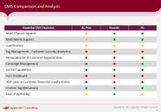
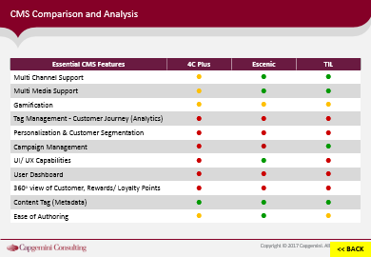
CMS Comparison and Analysis
Essential CMS features were listed based on the proposed value propositions. Three probable CMS were compared based on the essential CMS features
CMS | Analysis
4C Plus | 4C Plus CMS does not have the essential media, gamification, and personalisation capabilities required for the website
Escenic (CCI) | Escenic being a CCI product, will make the news publication process easier Escenic can also provide better multimedia support, and greater ease of authoring than 4C Plus
TIL | TIL CMS being inhouse, will be cost effective TIL CMS can also provide adequate multimedia support
Additional Capabilities Required
Escenic and the TIL CMS can be used but Gamification and Personalization capabilities should be added for best-in-class User-Experience
Recommendation
The CMS should be finalized during the implementation stage of the project
(i.e. after the workflows and business req. doc are made and ‘proof of concept’ is completed)

Slide 17
Thank You

Slide 18
Appendix

Slide 19

















Content Strategy Student News, Topic Oriented Content, Gamification of Learning
Phase 1 – Revamped Website Launch
Phase 2 – App Launch
(includes Gamification)
Format
Text Articles
Videos
Gamification
Quiz, Polls, Flashcards
Newsletter
Gamification Interactive Games
Original Content
Podcast, Video
Leaderboards, Badges, Quests, Levels, Virtual Goods, Rewards & Recog.
Channel
Responsive Website
Mobile Apps
Sources
Original Content
Partner Sourced
User Generated
Syndication
Partner Sourced
Premium Content

Slide 20







Personalization and Gamification Tools
PERSONALIZATION
GAMIFICATION
Personalization tool helps in customizing the content for the users based on their historical behavior and preferences set by them while using the website / app
Personalization helps in improving the user engagement time and also reduces the bounce rates
We have categorized personalization into to two categories – a) filter/preference/profile based, and 2) behavior based
Gamification platform provides customizable gamification elements designed to increase user interaction on websites
It involves badging, points, live notifications, and leaderboards.
Additionally these platform provides analytics to track user participation

Slide 21
CMS Comparison and Analysis
Essential CMS Features | 4C Plus | Escenic | TIL
Multi Channel Support | n | n | n
Multi Media Support | n | n | n
Gamification | n | n | n
Tag Management - Customer Journey (Analytics) | n | n | n
Personalization & Customer Segmentation | n | n | n
Campaign Management | n | n | n
UI/ UX Capabilities | n | n | n
User Dashboard | n | n | n
360º view of Customer, Rewards/ Loyalty Points | n | n | n
Content Tag (Metadata) | n | n | n
Ease of Authoring | n | n | n
<< BACK

Slide 22

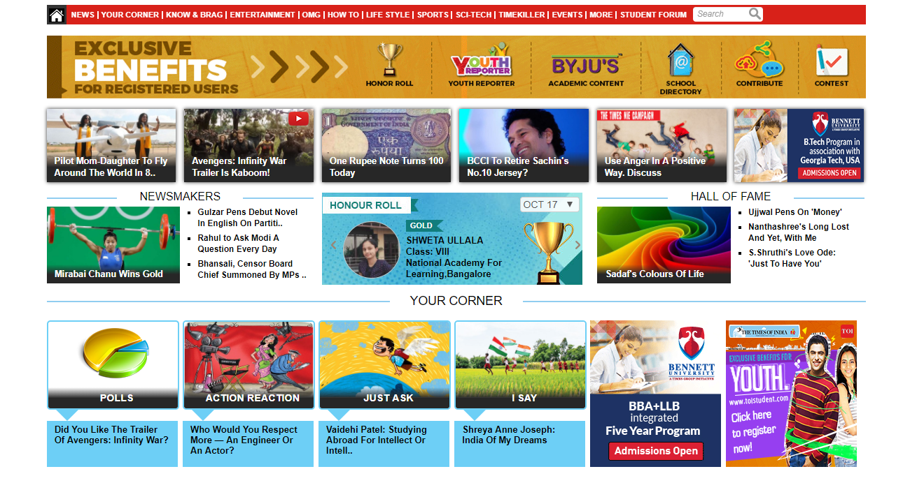

Slide 23
3 primary value propositions

Slide 24
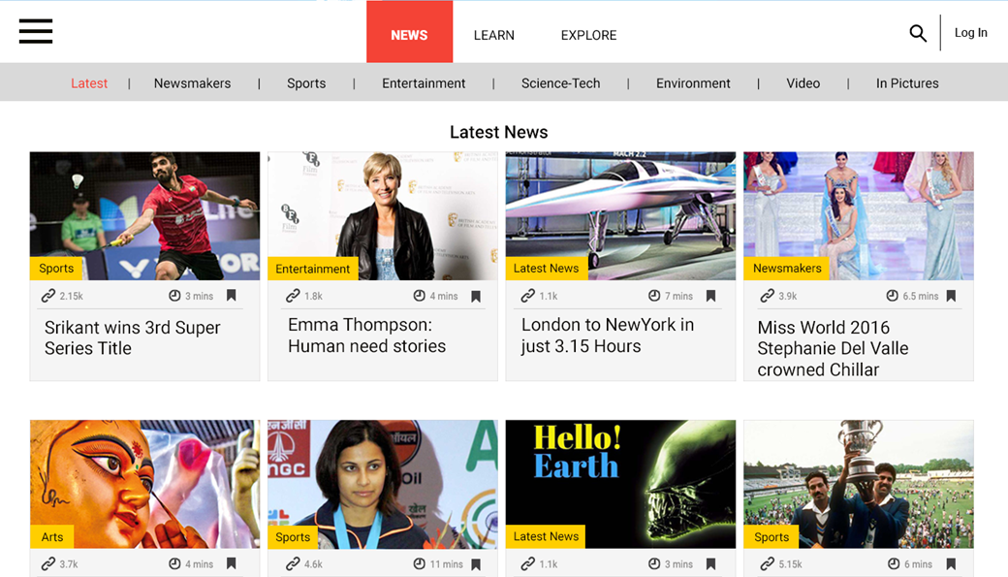


5 News Categories
Grid View
3 hr
Science-Tech
4.5
Webinar
5.0
5.0
Native Adv.
Student Reports!
4.5
4.0
5.0
5.0

Slide 25
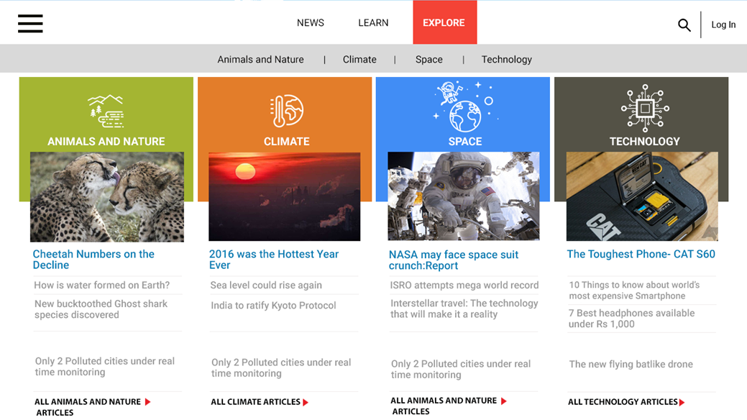



4 Topics
5.0
4.5
4.2
4.7
UGC
India Of My Dreams
by Shreya J
Your Corner
Victims of Anger
by Hardik K
Your Corner
Victims of Anger
by Roma R
Your Corner
Technology vs Human Relationships
by Shreya J
Your Corner

Slide 26
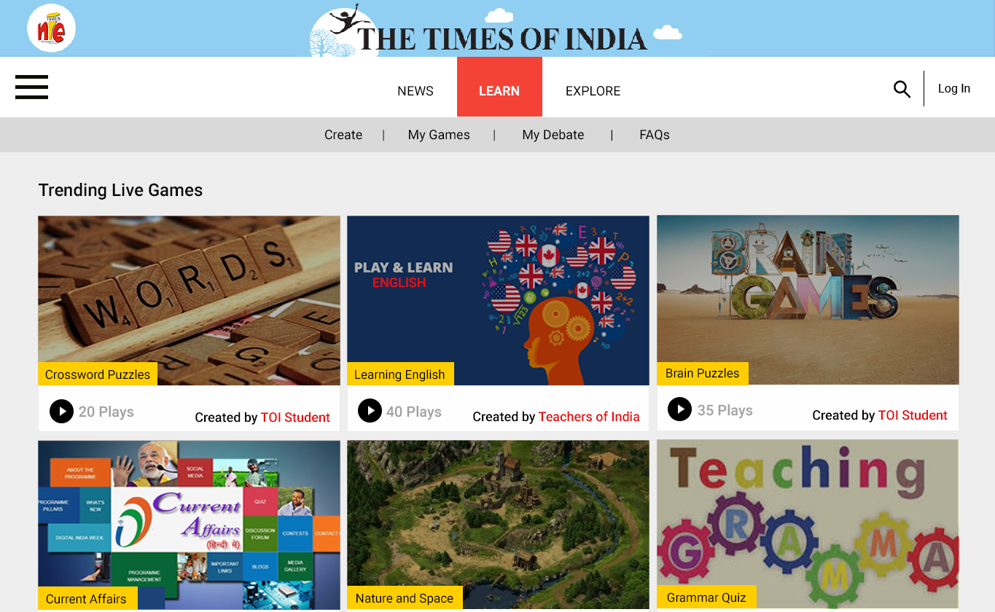
‘Create Game’ feature
Live Games
4.5
4.7
5.0
1 hr
41 min
4.7
Inter School Debate
4.5
<< BACK

